Slide 1


Air Cargo Booking & Tracking
Streamlining Logistics with Technology
A comprehensive solution transforming fragmented air freight operations into seamless, automated workflows through intelligent technology integration.

Slide 2

The Problem: Fragmented & Manual Air Cargo Processes
System Fragmentation
Manual Data Entry
Multiple airlines maintain separate booking and tracking portals, forcing freight forwarders to navigate dozens of disconnected platforms daily.
Tedious manual entry of Air Waybill (AWB) numbers across different websites wastes valuable time and introduces human error into critical processes.
Zero Visibility
Communication Breakdown
Lack of real-time, consolidated shipment visibility creates operational blind spots that cause delays, errors, and reactive problem-solving.
Inefficient communication channels between stakeholders lead to missed deadlines, lost shipments, and frustrated customers demanding answers.

Slide 3

Why It Matters: Impact on Business & Customers
Financial & Operational Impact
Shipment delays directly increase operational costs and risk expensive demurrage fees at airports worldwide
Lost or misplaced cargo reduces customer trust and damages brand reputation in competitive markets
Complex split shipments and customs clearance procedures add layers of unpredictability to delivery timelines
Modern customers demand transparency. Real-time tracking and proactive communication are no longer optional—they're the baseline expectation for professional air cargo services.

Slide 4
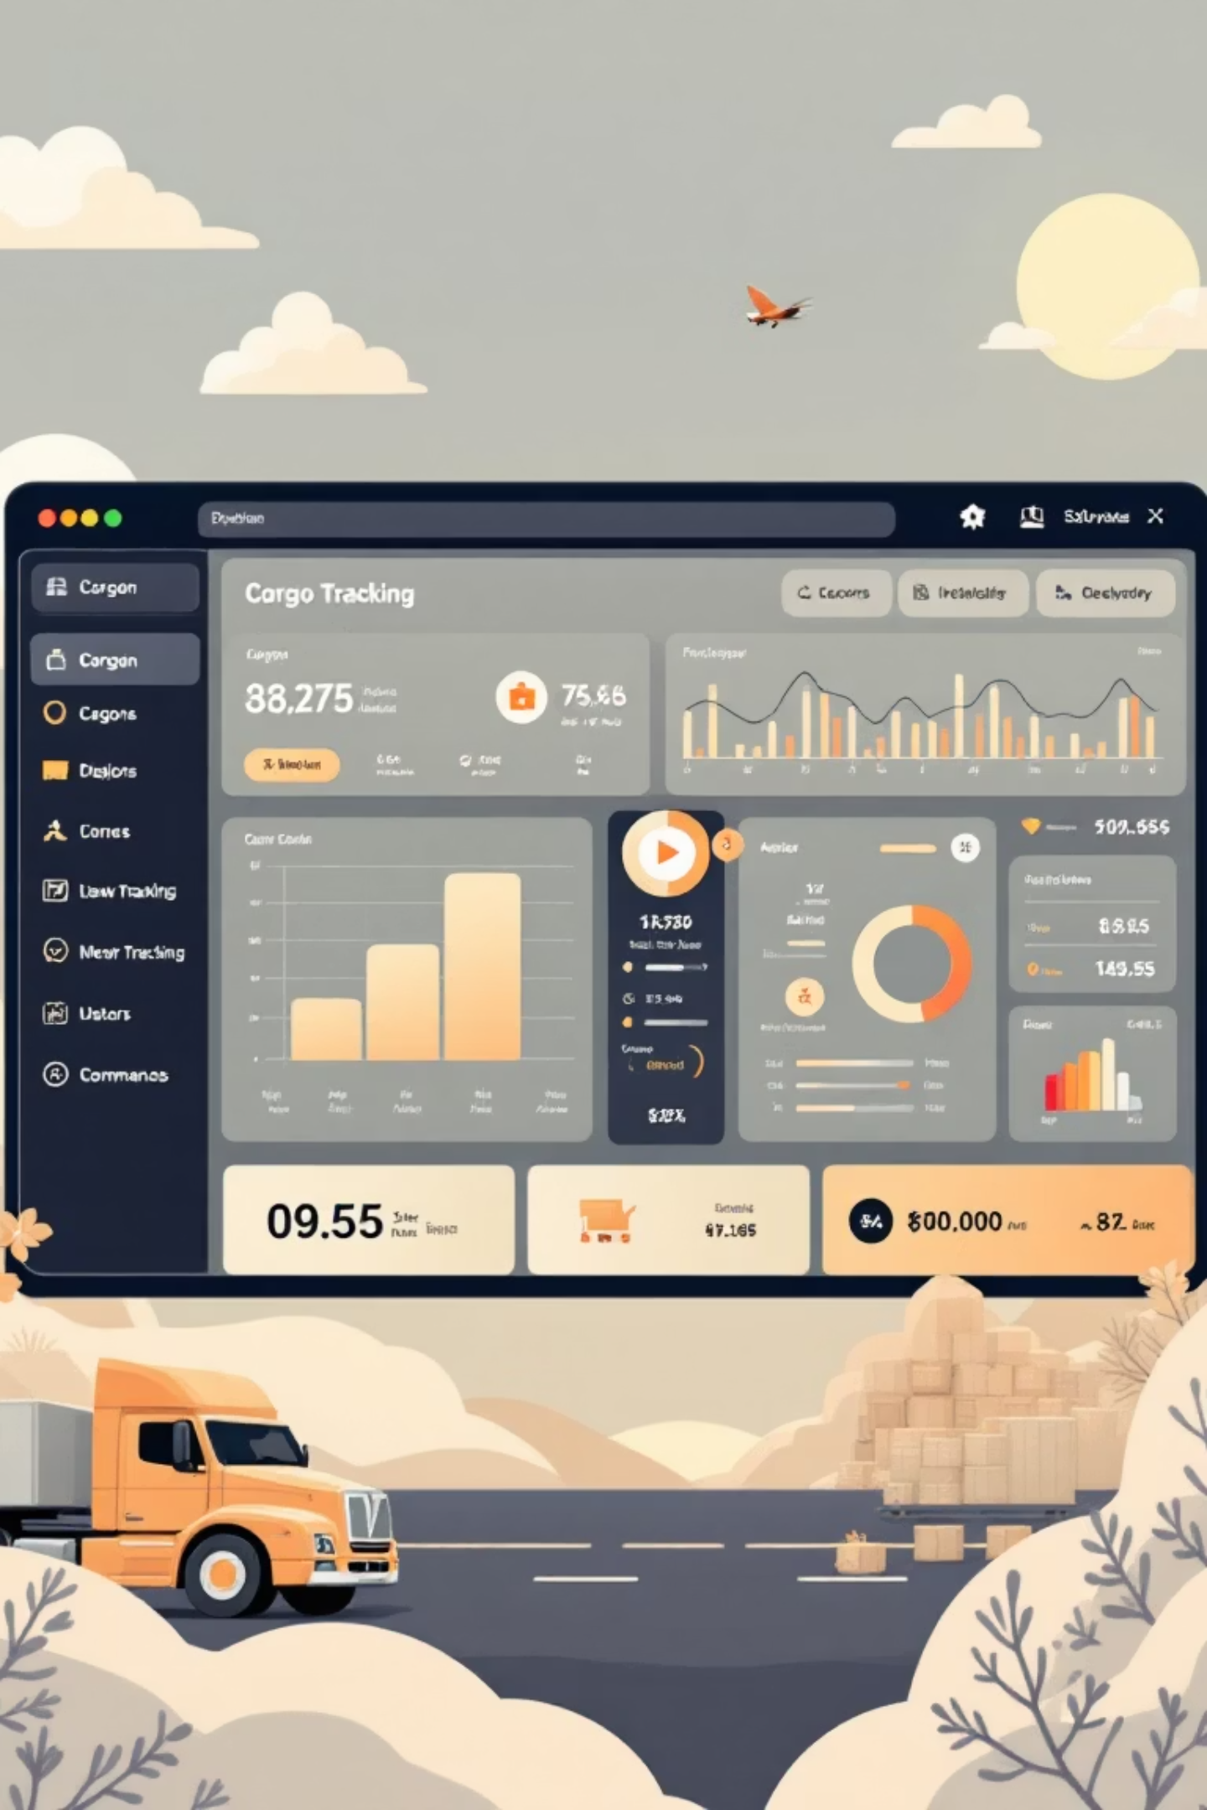
Introducing Our Solution
Integrated Air Cargo Booking & Tracking App
1
Java Backend Power
Robust API integrations with major airline systems, handling complex data processing and secure authentication protocols.
2
Beautiful Frontend
Responsive interface built with HTML and Tailwind CSS, delivering exceptional user experience across desktop and mobile devices.
3
Centralized Platform
Single dashboard to book shipments and track all AWBs in real-time, eliminating the need for multiple logins and systems.
4
Automated Intelligence
Smart data fetching from multiple airline APIs eliminates manual checks and provides instant status updates automatically.

Slide 5




How It Works: Key Features & Workflow
Smart Booking
Users book air cargo shipments through intuitive interface with instant rate comparison and schedule lookup across multiple carriers.
AWB Generation
System automatically generates and stores unique Air Waybill numbers, linking them to shipments with complete metadata tracking.
Real-Time Tracking
Live tracking updates pulled automatically from airline systems via secure API connections, refreshing every few minutes.
Unified Dashboard
Comprehensive view showing shipment status, current location, customs updates, delay alerts, and delivery confirmations in one place.

Slide 6

Technical Highlights: Java & Tailwind CSS in Action
Backend Architecture
Frontend Excellence
Java Spring Boot handles secure API calls, complex data processing, and mission-critical business logic
Tailwind CSS delivers clean, mobile-responsive UI with fast load times and consistent styling
Component-based HTML structure maintains code quality and enables rapid feature deployment
RESTful services enable seamless, standardized communication with diverse airline systems globally
Modular design supports easy scalability for adding new airlines, shipment types, and tracking features
Microservices design ensures reliability and independent scaling of booking, tracking, and notification modules

Slide 7


Use Case: Pharmaceutical Shipment Monitoring
Temperature-Sensitive Insulin Delivery
01
02
Integrated Monitoring
Proactive Alerts
Temperature sensors connected directly to tracking app provide continuous cold chain visibility.
Real-time notifications on customs delays enable immediate temperature control adjustments.
03
Compliance Assurance
Prevents spoilage and ensures strict adherence to pharmaceutical regulations and quality standards.
Result: 95% reduction in temperature excursions, zero product loss incidents, and full regulatory compliance across international routes.

Slide 8

Use Case: E-commerce Air Freight Visibility
Consolidated Tracking
1
Single interface tracks split shipments across multiple carriers and routes, eliminating the chaos of fragmented visibility.
Customer Automation
2
Automated notifications keep customers informed on shipment milestones, delays, and estimated delivery times without manual intervention.
Smart Planning
3
Enables better inventory forecasting and warehouse preparation through accurate, real-time arrival predictions.
Outcome: Customer satisfaction scores increased 42%, support inquiries dropped 68%, and inventory accuracy improved to 99.2%.

Slide 9

Benefits Summary: Why Choose Our App?
Save Time
Improve Security
Automate booking and tracking across all airlines, reducing manual work by up to 80% and freeing teams for strategic tasks.
Enhanced shipment security with real-time monitoring reduces risk of loss, theft, or mishandling throughout the supply chain.
Boost Efficiency
Build Trust
Centralized data and intelligent alerts streamline operations, eliminate redundant processes, and accelerate decision-making.
Transparent, real-time shipment visibility transforms customer relationships and establishes your brand as a reliability leader.

Slide 10

The Future of Air Cargo Logistics
Connected. Transparent. Efficient.
Transform Operations
Global Excellence
Embrace technology to revolutionize air freight operations and eliminate legacy inefficiencies.
Deliver faster, safer, and smarter shipments to every corner of the world with confidence.
Build Together
Partner with us to create the next generation of air cargo booking and tracking solutions.
Ready to transform your air cargo operations? Let's build the future of logistics technology together and set new standards for the industry.

